Slide 1
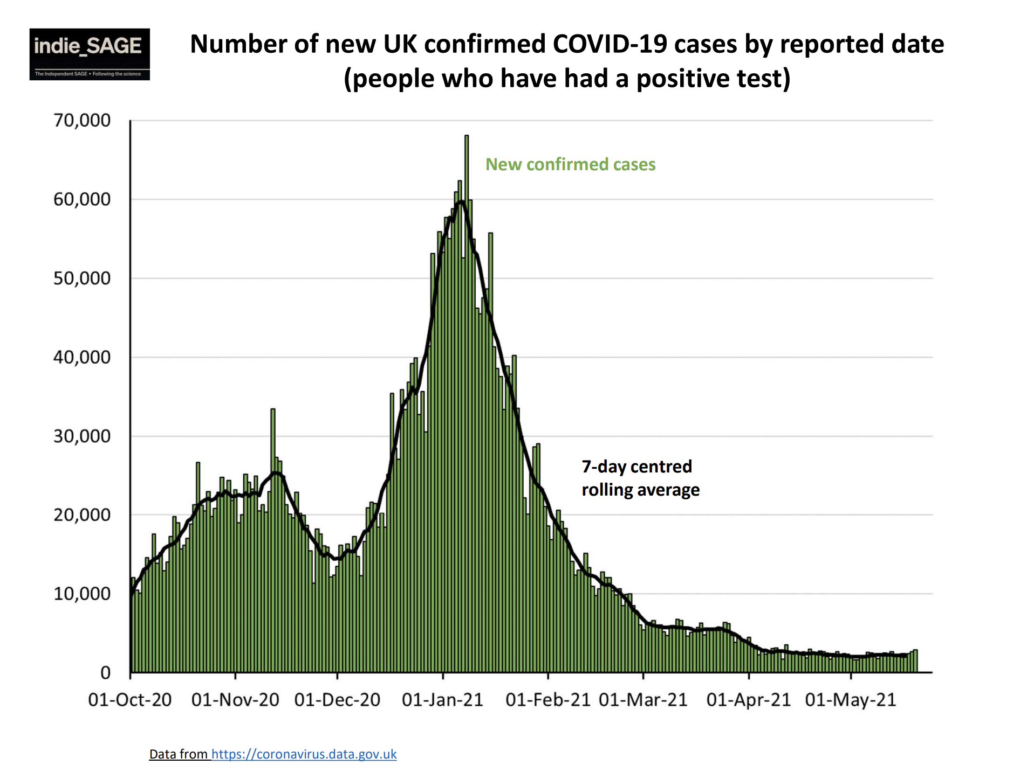
Fuente: Weekly Briefing Independent Sage - UK, 21st May 2021, https://www.independentsage.org/

Slide 2
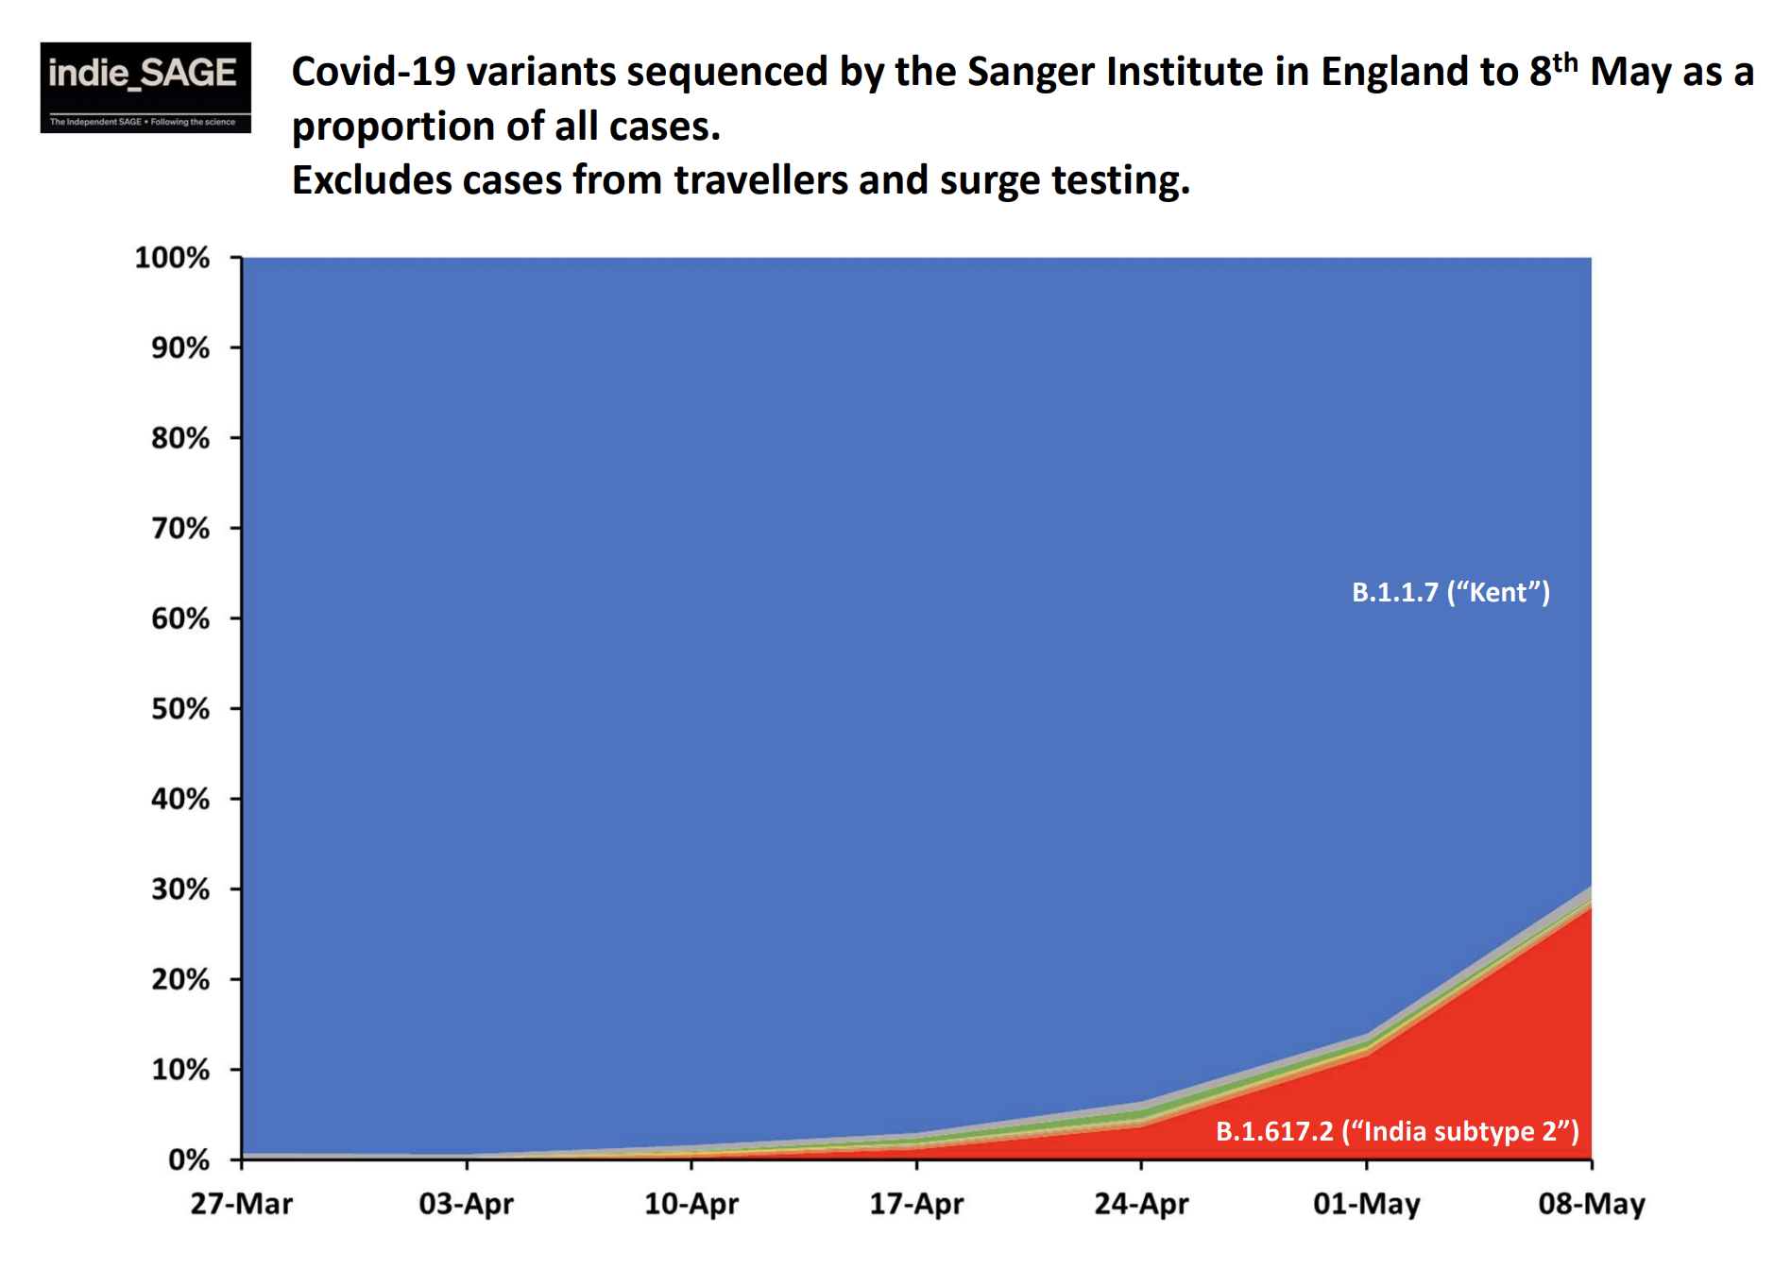
Fuente: Weekly Briefing Independent Sage - UK, 21st May 2021, https://www.independentsage.org/

Slide 3
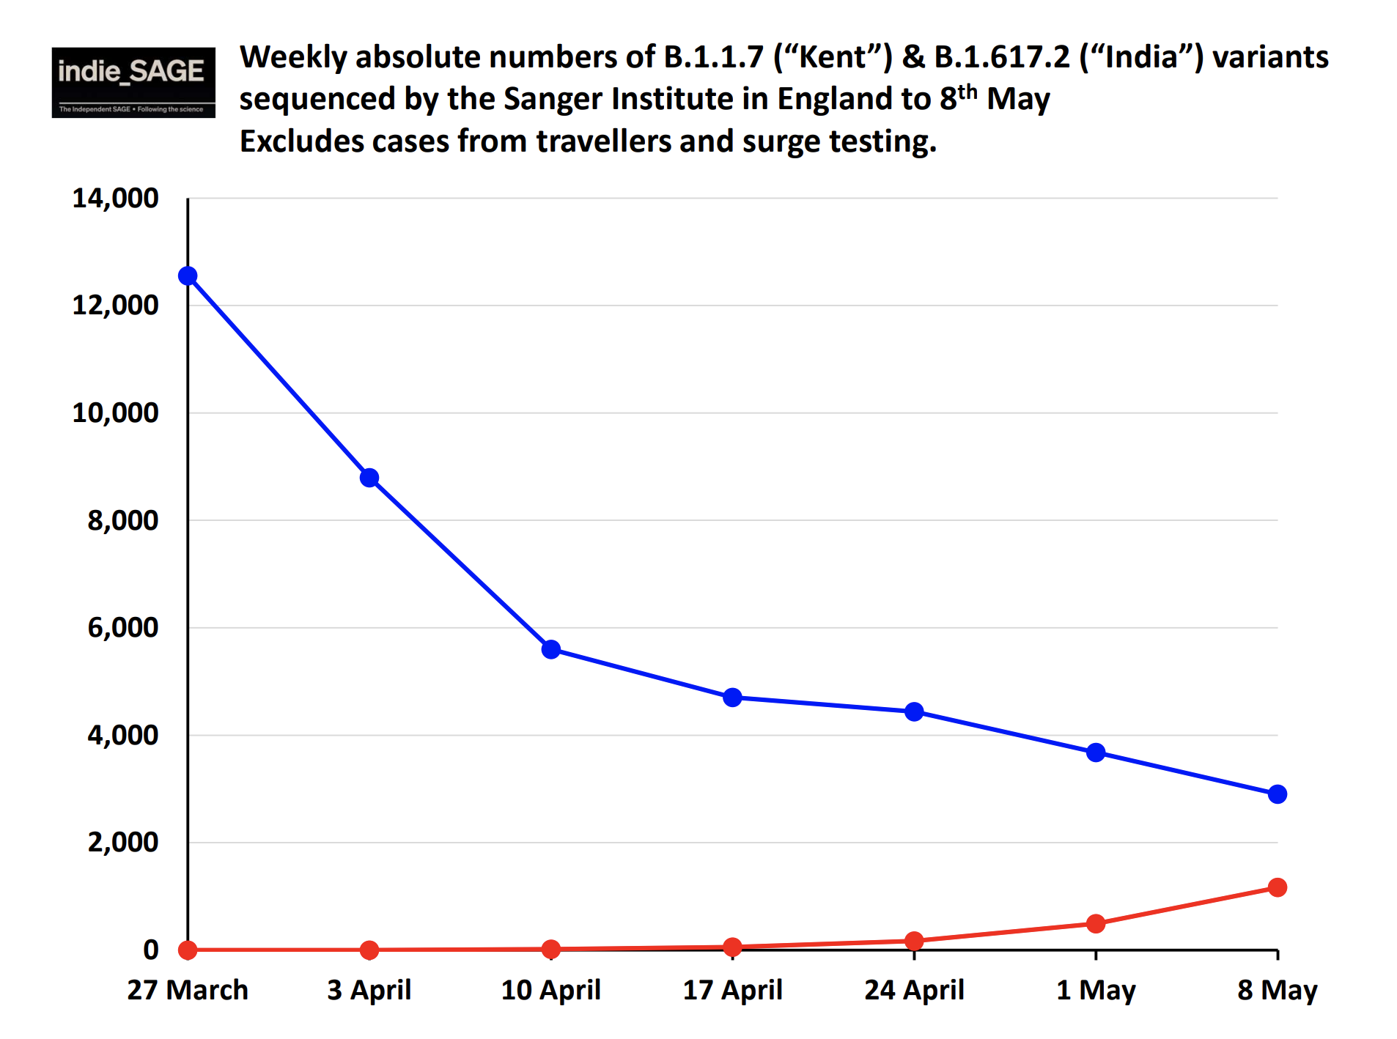
Variante Alfa (Británica)
Variante Delta
Fuente: Weekly Briefing Independent Sage - UK, 21st May 2021, https://www.independentsage.org/

Slide 4
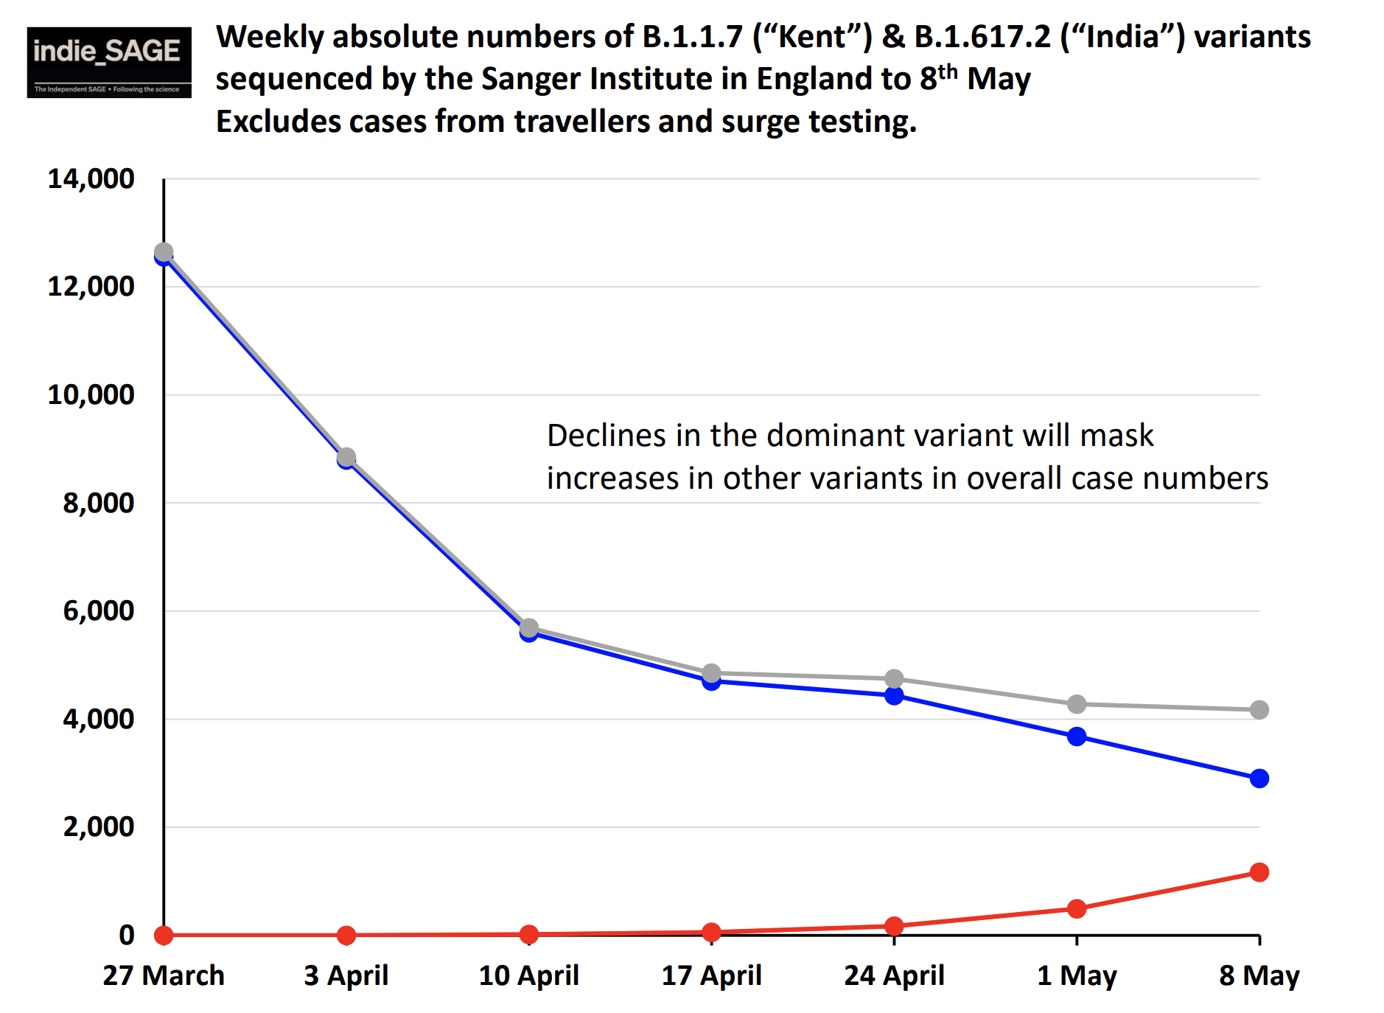
Evolucion observada
Fuente: Weekly Briefing Independent Sage - UK, 21st May 2021, https://www.independentsage.org/

Slide 5
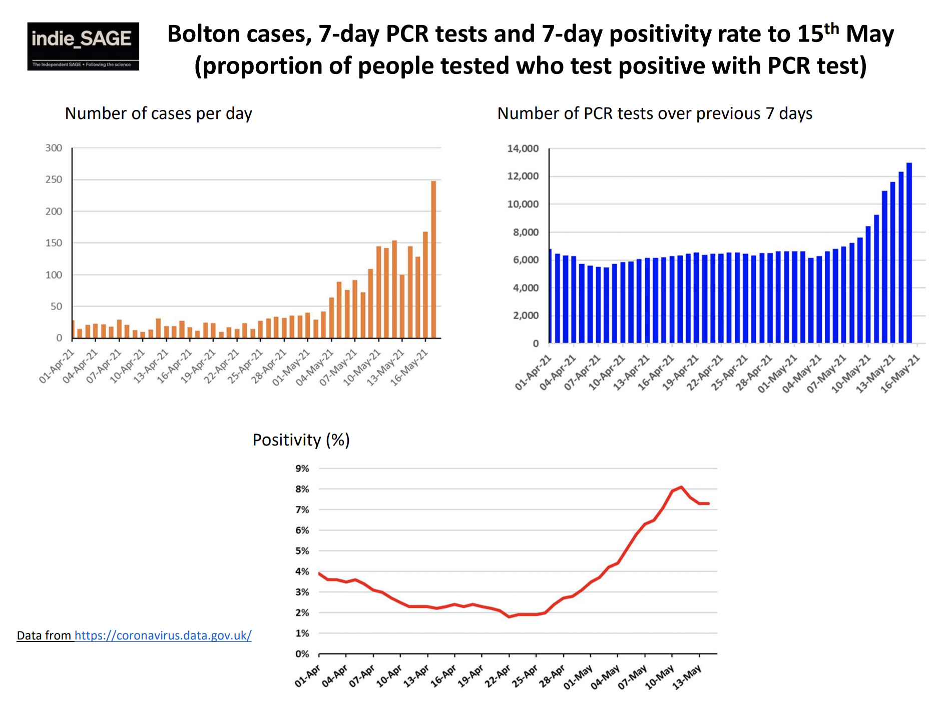
Fuente: Weekly Briefing Independent Sage - UK, 21st May 2021, https://www.independentsage.org/

Slide 6
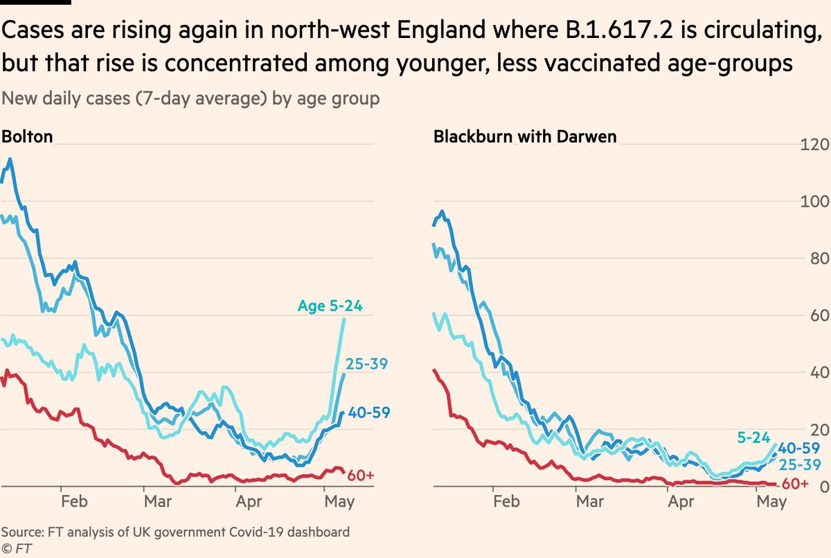
Fuente: Financial Times

Slide 7
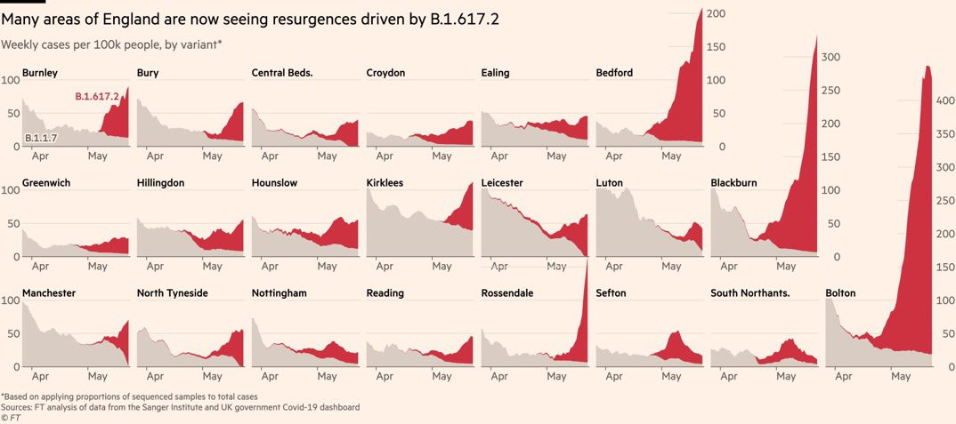
Fuente: Financial Times

Slide 8
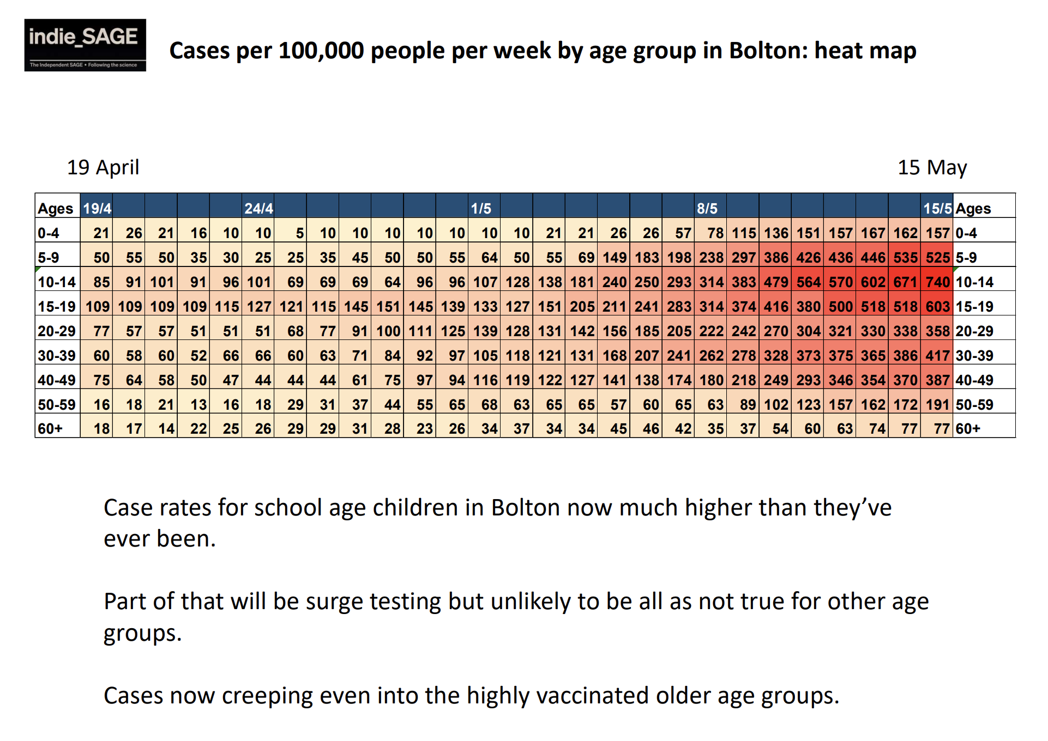
Fuente: Weekly Briefing Independent Sage - UK, 21st May 2021, https://www.independentsage.org/

Slide 9
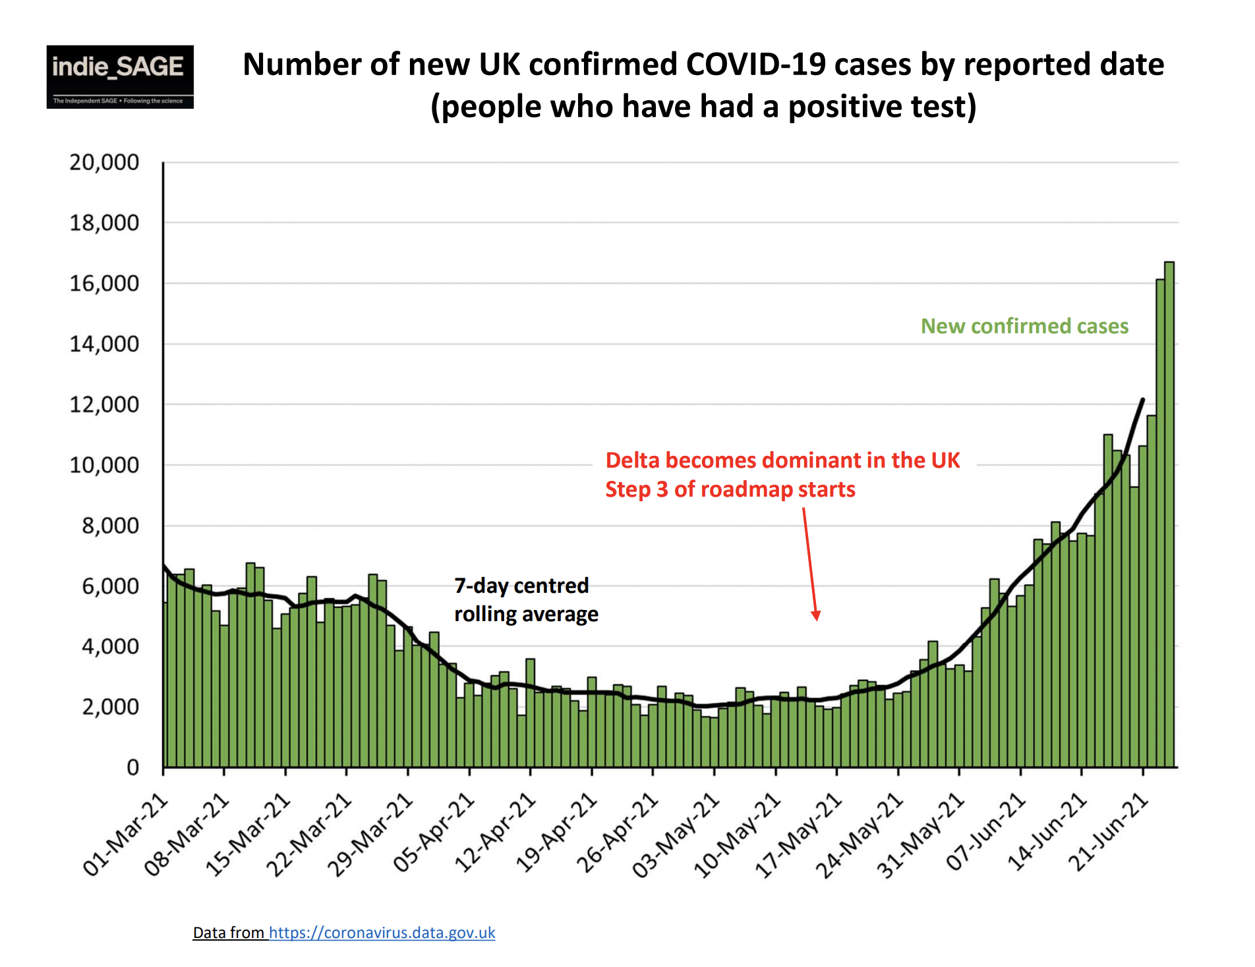
Fuente: Weekly Briefing Independent Sage - UK, 25 Junio 2021, https://www.independentsage.org/

Slide 10
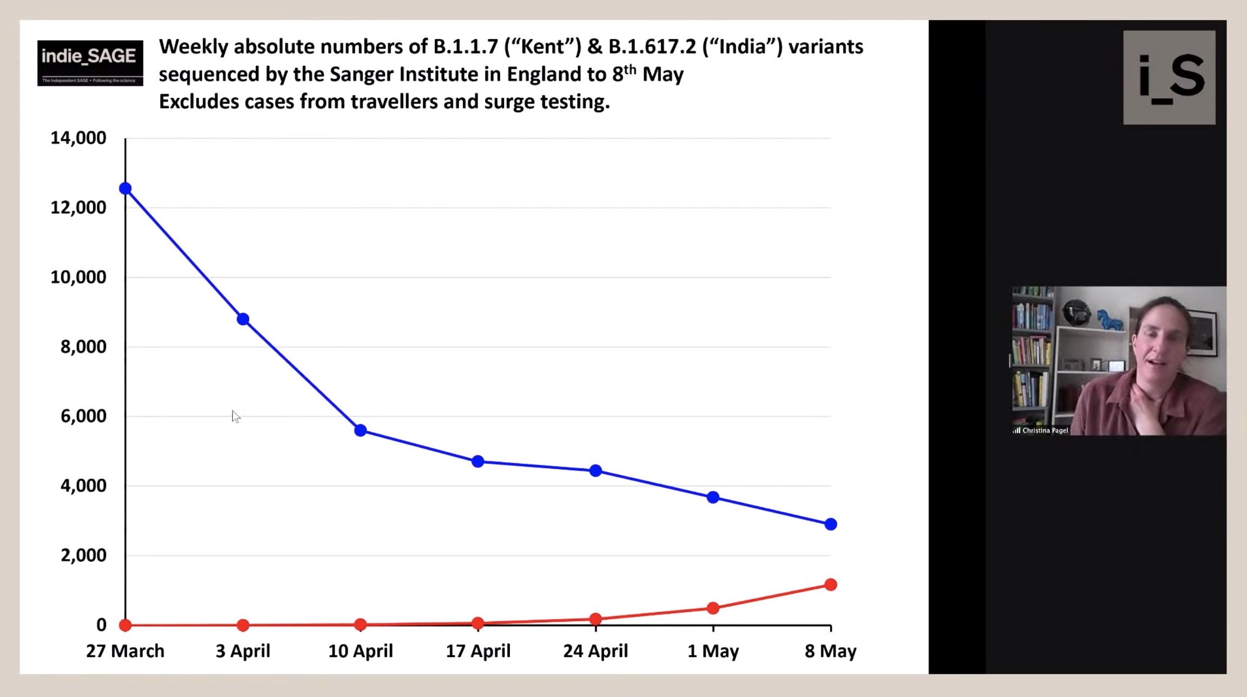

Slide 11
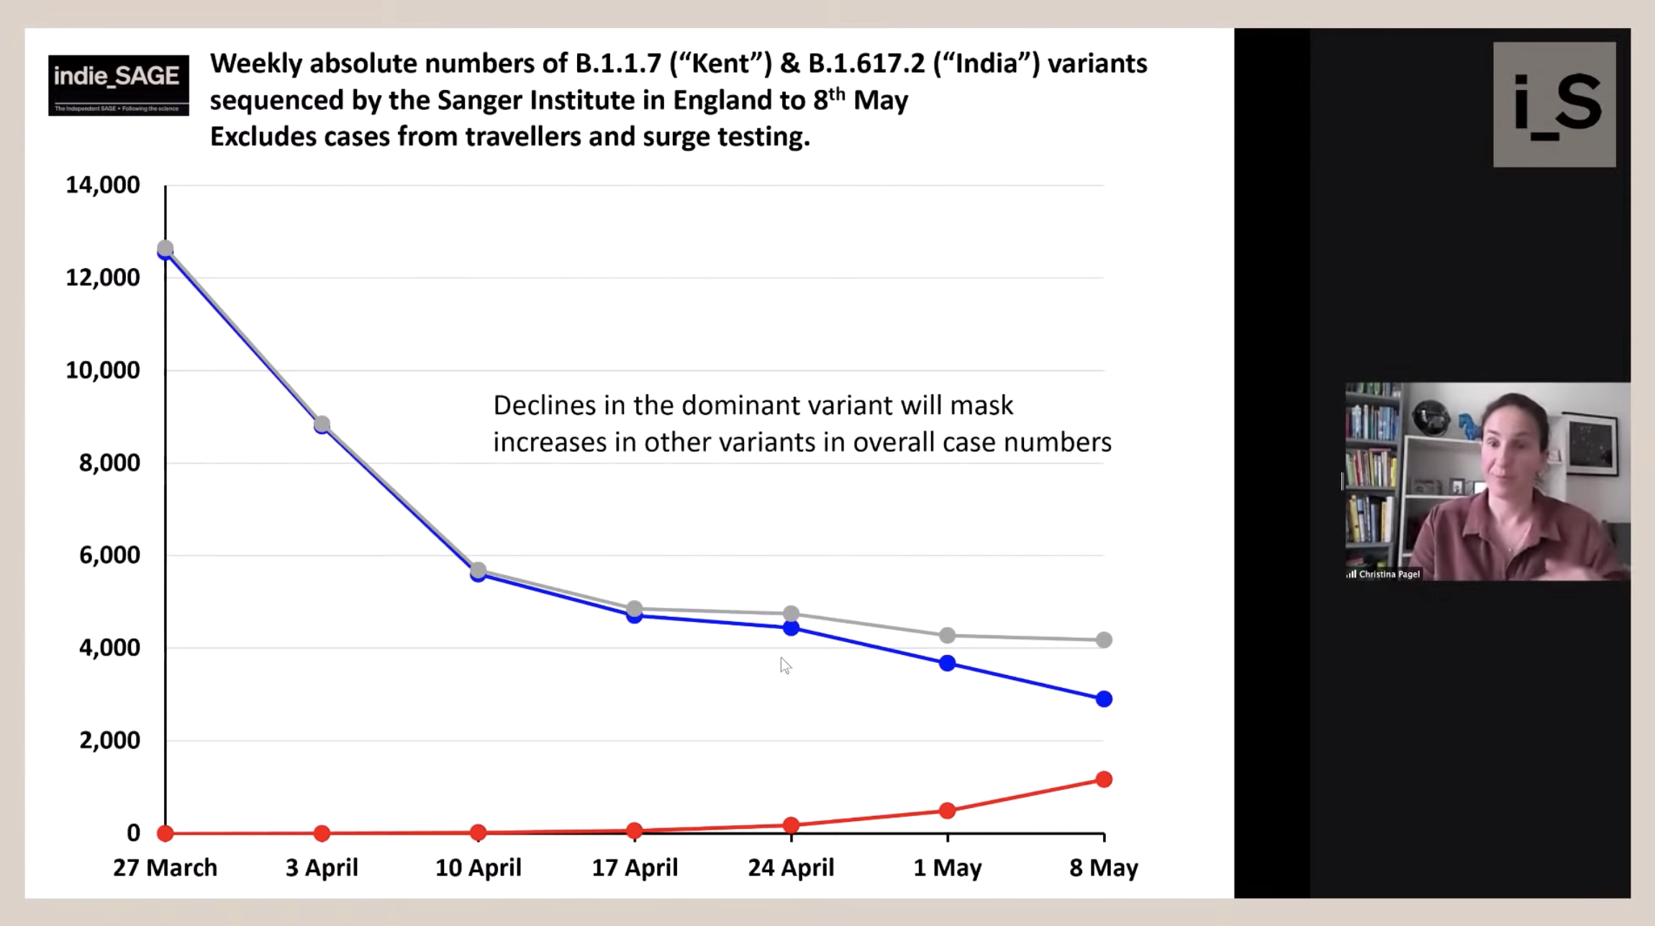

Slide 12
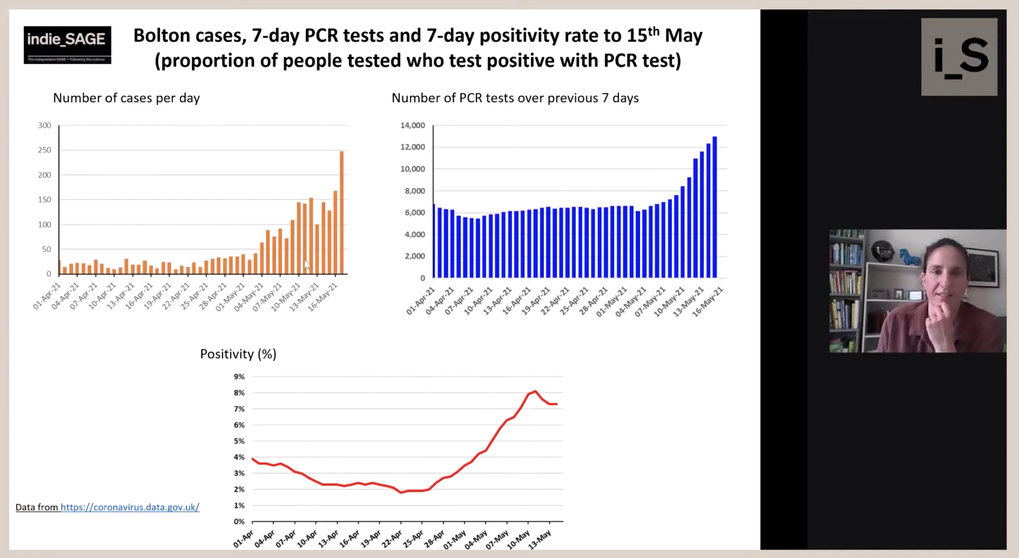

Slide 13
